Slide 1
Database
Management System
Lecture - 41

Slide 2
Updating Multiple tables
One at a time
CREATE VIEW st_pr_view1 (a1, a2, a3, a4) AS (select stId, stName, program.prName, prcredits from student, program WHERE student.prName = program.prName)

Slide 3
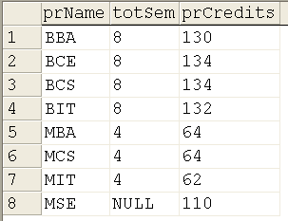
insert into st_pr_view1 (a3, a4) values ('MSE', 110)
Select * from program

Slide 4
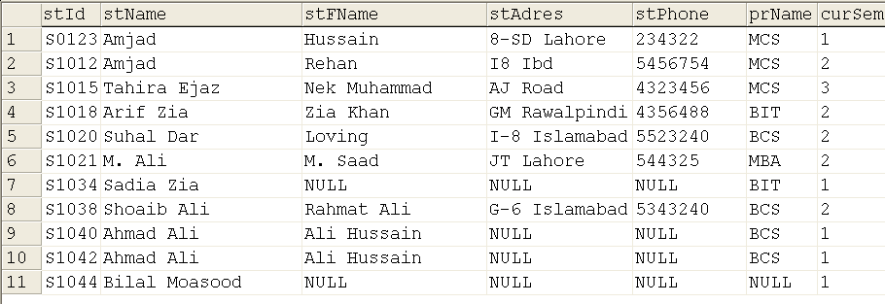
insert into st_pr_view1 (a1, a2) values (‘S1043', ‘Bilal Masood’)
SELECT * from student

Slide 5
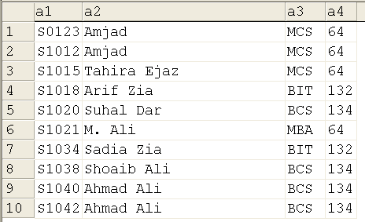
Interesting Thingi
Select * from st_pr_view1

Slide 6
Aggregate functions
CREATE VIEW st_view3
(a1, a2) AS
(select prName, avg(cgpa) from student group by prName)
Select * from st_view3

Slide 7
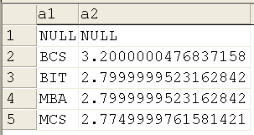

Slide 8

Materialized Views
Views are virtual tables
Query executed every time
For complex queries involving large number of join rows and aggregate functions
Problematic

Slide 9
Materialized Views
Solution is materialized views also called indexed views created through clustered index
Creating a clustered index on a view stores the result set built at the time the index is created.

Slide 10
Materialized Views
An indexed view also automatically reflects modifications made to the data in the base tables after the index is created, the same way an index created on a base table does.

Slide 11
Materialized Views
Create indexes only on views where the improved speed in retrieving results outweighs the increased overhead of making modifications.

Slide 12
Materialized views
alter view st_view1 with schemabinding as (select stName, stFname, prName from dbo.student where prName = 'MCS')

Slide 13
Materialized Views
create unique clustered index stdview_ind1 on st_view1 (stfname)

Slide 14
Partitioned Views
Lets not discuss it
Idea is, data lying at multiple places and combined in a view
Same table partitioned horizontally based on some condition

Slide 15
Simple or Complex Views
One form of classification
View on single table is simple, while involving multiple tables is called complex view
There is lot more on views

Slide 16
Transaction Management

Slide 17
Transaction Management
Comprises
  Database Recovery
  Concurrency Control

Slide 18
Transaction
The base of Transaction Management (TM)
A logical unit of work performed on the database
May involve one or more operations

Slide 19
Database
Management System
Lecture - 41

